Slide 1
Hibbard Deletion Degradation
By Iulian Preda

Slide 2
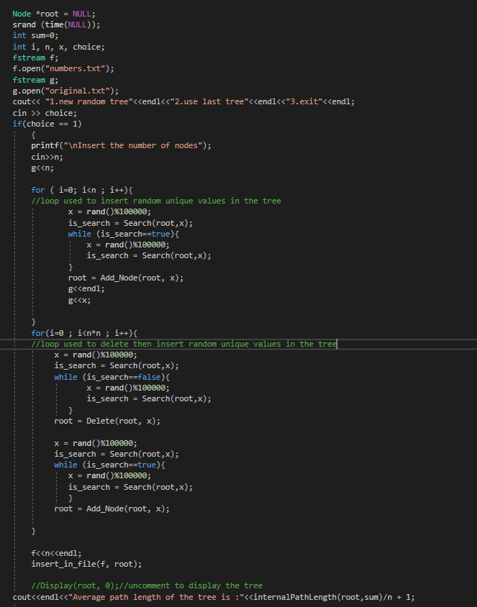
This is the main function used to insert, delete and insert again keys in the tree.
To be able to control the experiment, all the numbers saved in the tree are copied in a file.
At the end of the code you can see the function that calculates the internal path length being called.

Slide 3
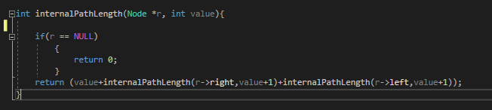
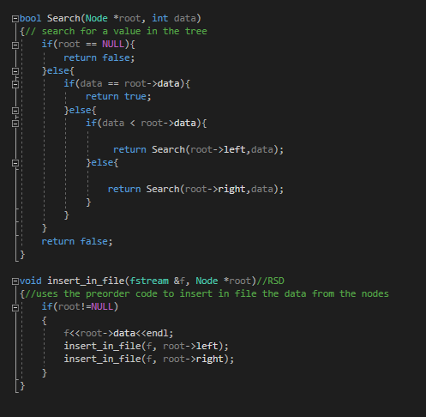
On the next 2 slides you can see the most important functions.

Slide 4
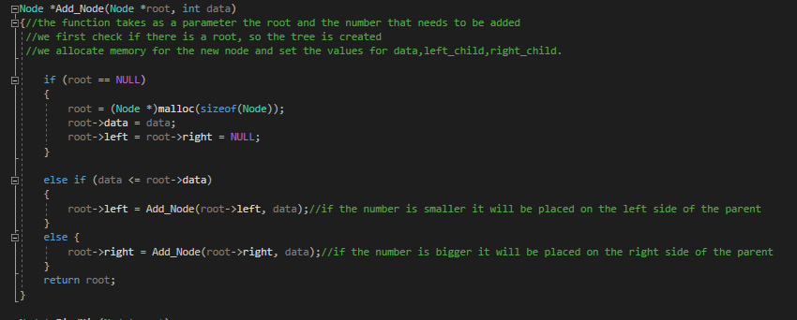
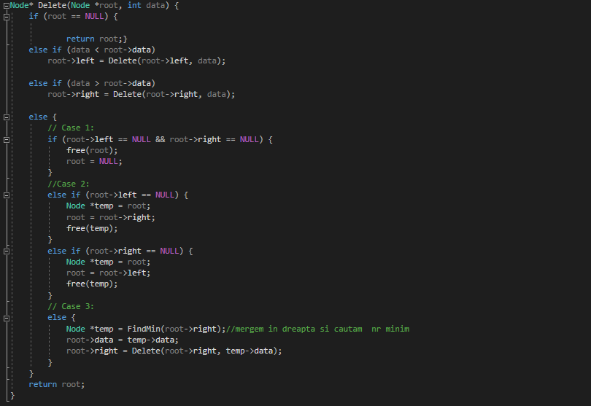

Slide 5
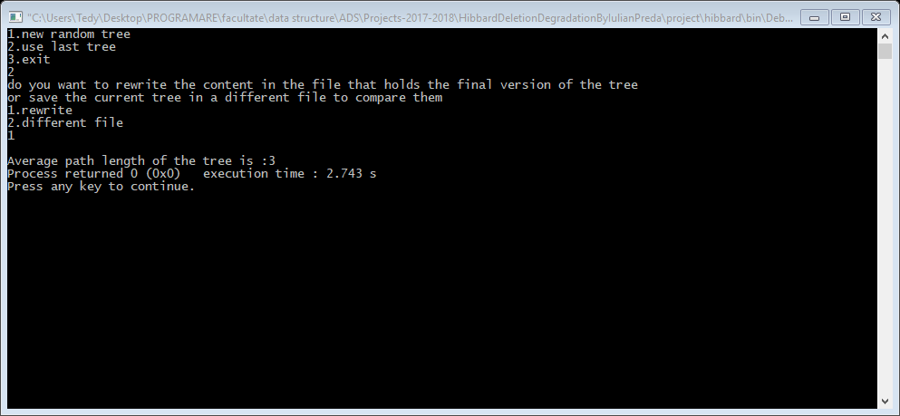
Interface

Slide 6
Results

Slide 7
Conclusion
The average internal path length is smaller than the square root of the number of nodes.

